Slide 1
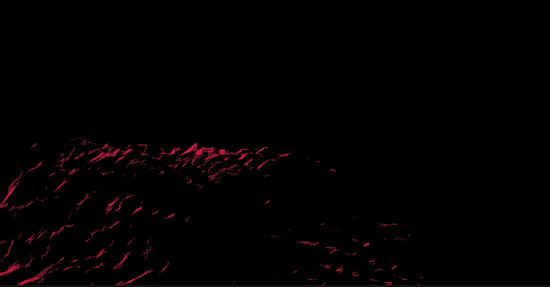

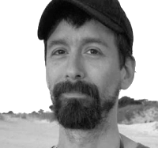



PROJECT BY FLACO GAMES
WHO IS TALKING TO YOU?
Juan Pedro Salvo
We are an experienced Uruguayan team.
Selected by Coconat retreat to be part of the Rabbits event. We are looking to make our game and team known.
Creative Director / Producer
Tamara F. Luna
TF
Environment / VFX
Notes:
Hello, we are Juan and Tamara and we come from Montevideo, Uruguay
The land of cows, mate, dulce de leche and… legal marihuana
We are part of Flaco games, and we been selected by Coconat Retreat to be part of the Rabbits Indie Games Residency here in Germany
we are very happy to be here
We want to present our project to you

Slide 2
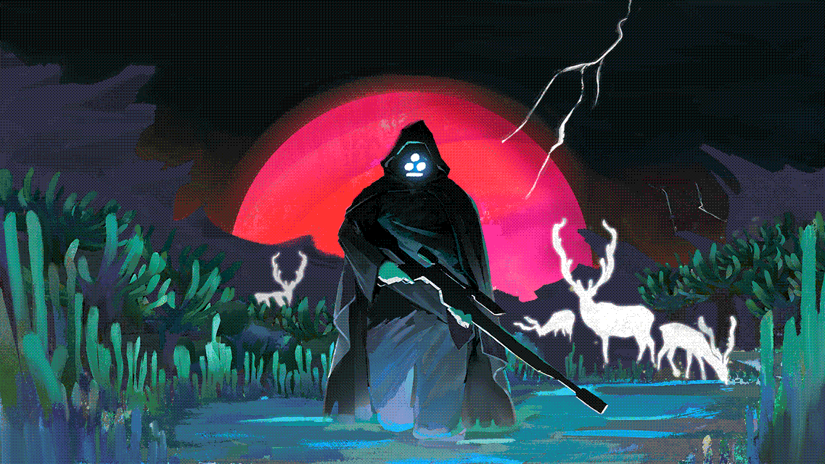
LUNAR HUNTER

Slide 3
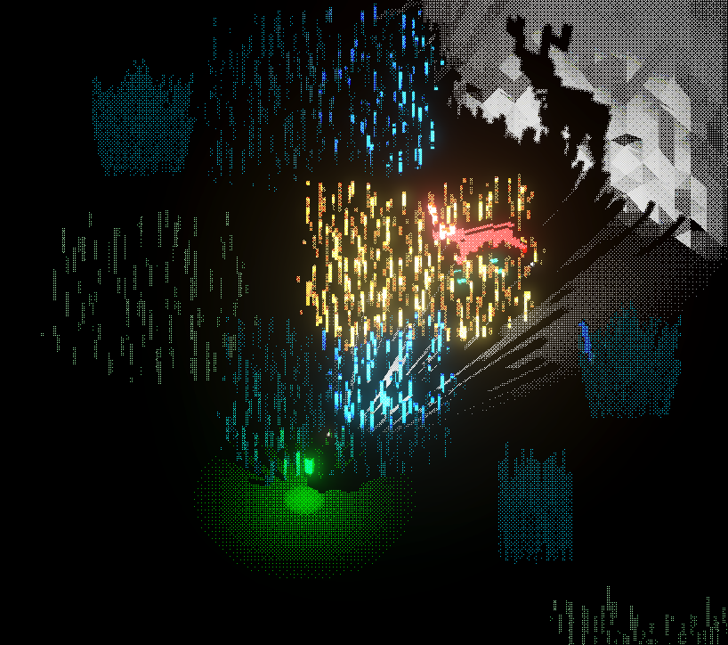
LUNAR HUNTER
WHAT IS LUNAR HUNTER?
Genre: Survival horror / hunting • Single-player
Lunar Hunter is a hunting focused-survival game with an ecological-horror theme.
You play as the lone keeper of a space beacon, in a planet populated by bioluminescent creatures.

Slide 4
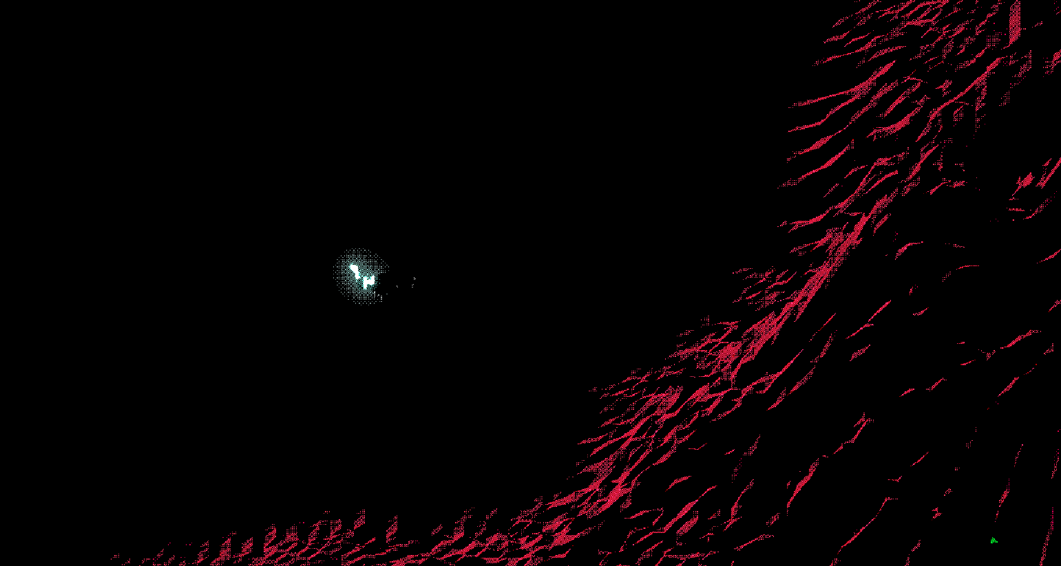
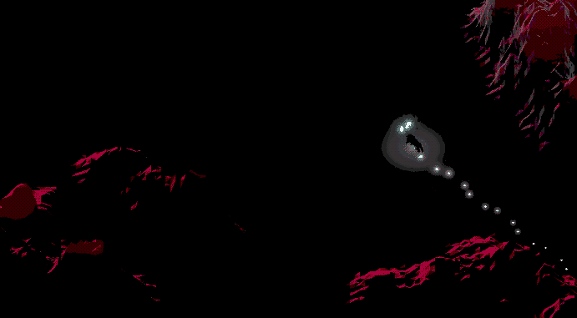
LUNAR HUNTER
THE NEED
FLACO GAMES
Looking at Hunter players niche
Hunting systems bring frustration
Other survival aspects are priority
Hunting is tedious and unsatisfying
Hunting is not the focus

Slide 5



LUNAR HUNTER
THE DESIRE
FLACO GAMES
Fishing like hunting mechanic
SCOPE and Dark themed
Open Exploration
Exploration of the unknown

Slide 6
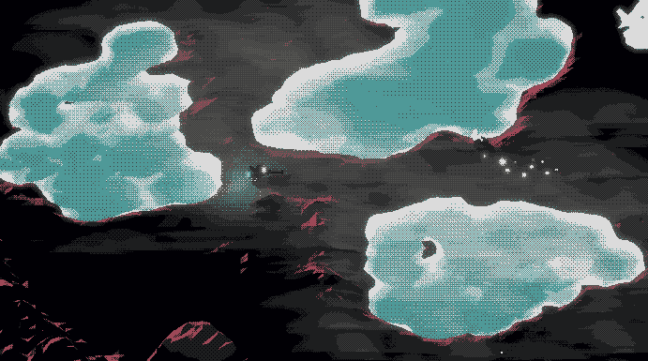
LUNAR HUNTER
HUNT-FOCUSED SURVIVAL
EMERGENT ENCOUNTERS
FLACO GAMES

Slide 7
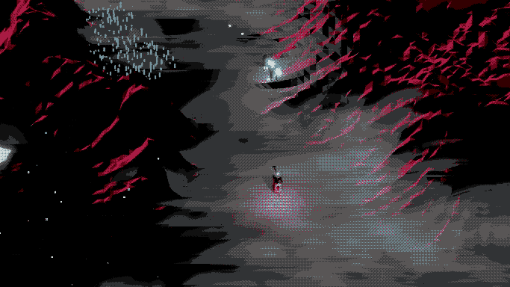
LUNAR HUNTER
GROUNDED HUNTING /
IMMERSIVE FEEL
FLACO GAMES

Slide 8
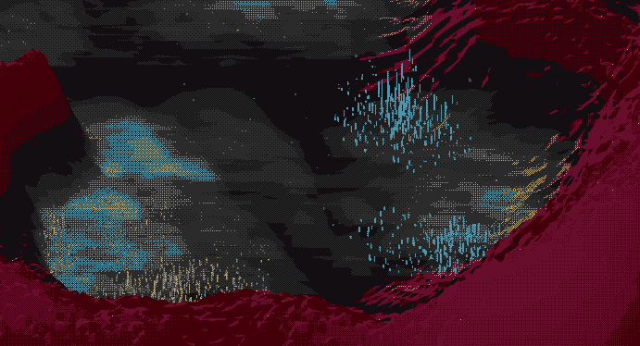
LUNAR HUNTER
GAME SCOPE
LUNAR HUNTER
FLACO GAMES
13
5
13 HRS
CREATURES TO HUNT
BIOMES
ESTIMATED PLAYTIME
FOR STORY MODE

Slide 9
LUNAR HUNTER
CURRENT TIMELINE
LUNAR HUNTER
FLACO GAMES
Q4 2026
Q1 2027
CLOSED GAME LOOP
Demo Ready
Rabbits Game Residency
Games Ground Festival
In Game Tutorial
Demo ready to upload to Steam
PUBLISHER’s INVESTMENT
Q2 2027
Q3 2027
Q4 2027
ALPHA
BETA
GOLD
Expand the rest of the planet, creatures and biomes
Heavy playtesting
Applying feedback from playtests
Balance and more testing
Adding epilogue
Polishing every discipline
Publish the thing!

Slide 10
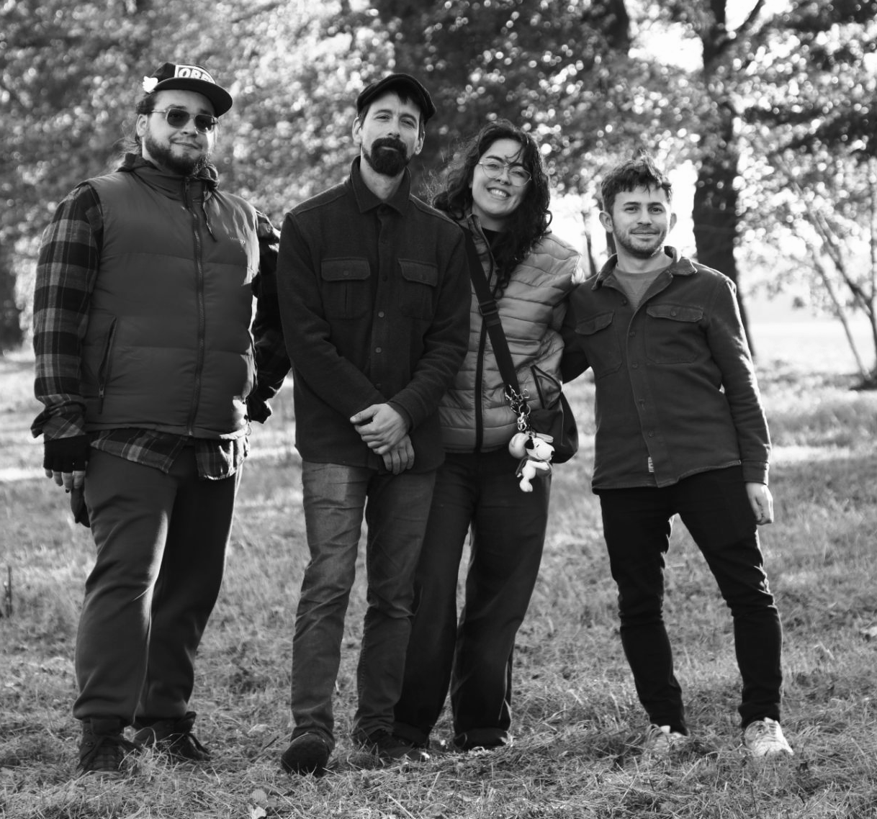

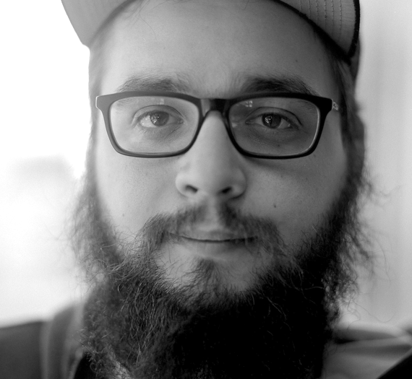
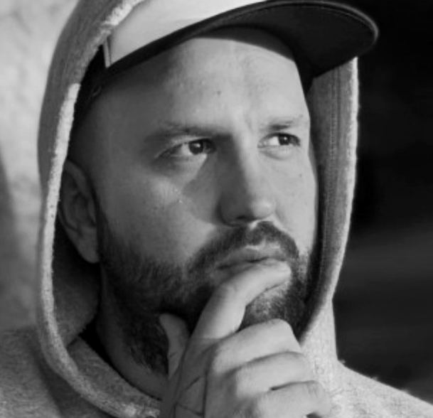

LUNAR HUNTER
OUR TEAM
LUNAR HUNTER
FLACO GAMES
MULTIDISCIPLINARY TEAM
Juan Pedro Salvo
Tamara F. Luna
Creative Director / Producer
Environment / VFX
Adrián Bayardi
Fede Debellis
Programmer
Game / Level Design
Álvaro Riet
Joaquín Tomé
ÁR
Narrative Design
Sound Design / Music
Lunar Hunter team during the Coconat Rabbit event

Slide 11

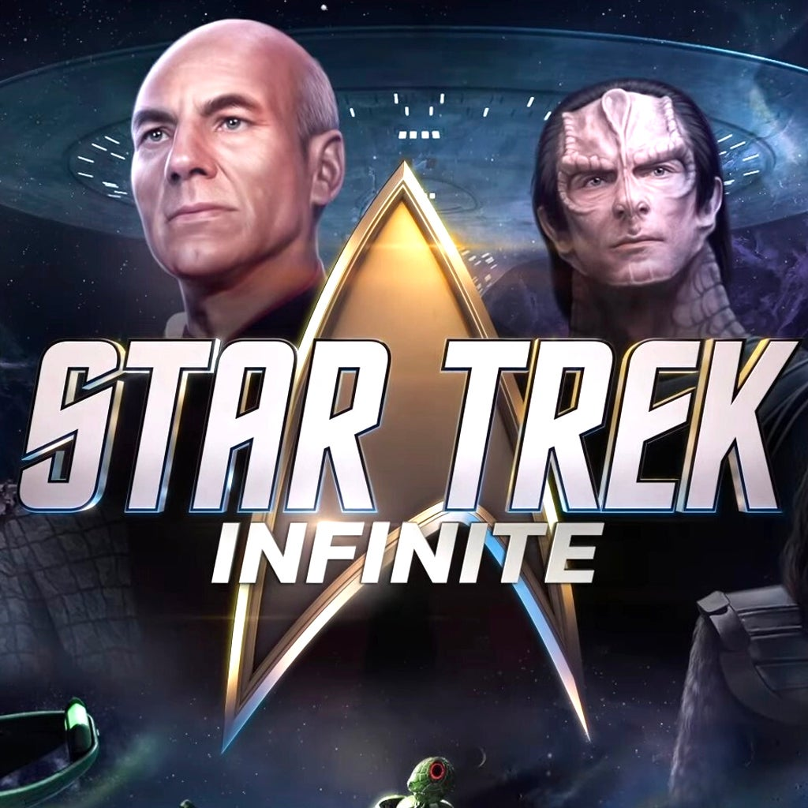










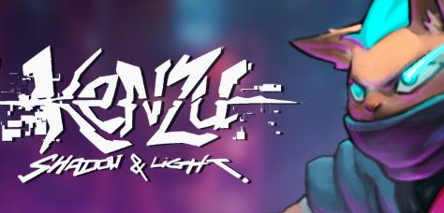


LUNAR HUNTER
OUR TEAM EXPERIENCE
LUNAR HUNTER
FLACO GAMES

Slide 12
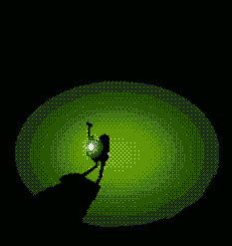
LUNAR HUNTER
WHAT WE ARE LOOKING FOR
LUNAR HUNTER
FLACO GAMES
Watch this project grow!
We’re officially looking for a publisher to help
fund the next phase of development
Come talk to us :)

Slide 13
LUNAR HUNTER
LUNAR HUNTER
FLACO GAMES
LUNAR HUNTER
lunarhunter.com
lunarhunter@flacogames.com

